Slide 1
Defensive Security Project
by: Cameron Wallace

Slide 2
Table of Contents
This document contains the following resources:
Monitoring Environment
Attack Analysis
Project Summary & Future Mitigations

Slide 3

Monitoring Environment
‹#›

Slide 4
Scenario
You’re working as a SOC Analyst for a virtual reality company called VSI.
JobeCorp, a rival company of VSI, is rumored to be launching a variety of cybersecurity attacks against VSI.
As a SOC Analyst, your job is to review past logs for an Apache web-server and a Windows OS, and design a series of reports, alerts, and dashboards to effectively monitor for any signs of threat-activity.

Slide 5
[“Add-On” App]
‹#›

Slide 6
Website Monitoring
-Website Monitoring is a simple Add-on App built for the express purpose of tracking websites to provide real-time, accurate monitoring of the web-server’s status and response time.
-Additional features of the app includes the ability to review detailed metrics of connection failures and availability, along with reports on the changes made to any and all websites currently being monitored.
-Able to set up alerts to track and monitor all of the aforementioned metrics.
-A convenient, easy-to-use UI that allow for complete configuration of any input data.

Slide 7
Website Monitoring
Scenario:
-Using Website Monitoring, you are able to provide input in the form of your company’s web-servers, change the interval of checks at will, and have a well defined UI that allows for simple and easy visualization of the response code, the most recent response times, the average response time, and the effective range of responses.
-All of this info in a digestible format means that an analyst would be able to quickly determine if their clients’ servers are experiencing any form of targeted attack.

Slide 8
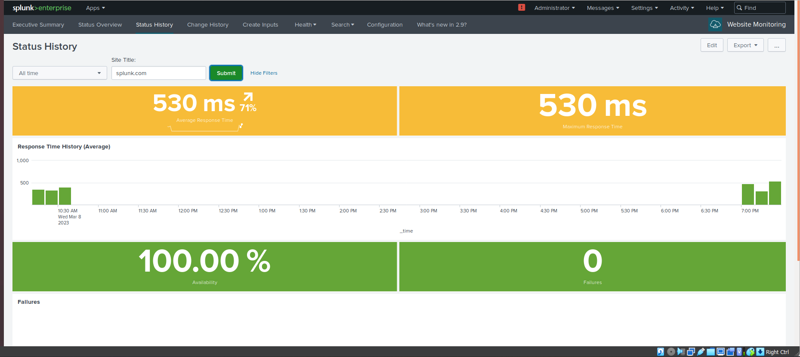
Website Monitoring

Slide 9
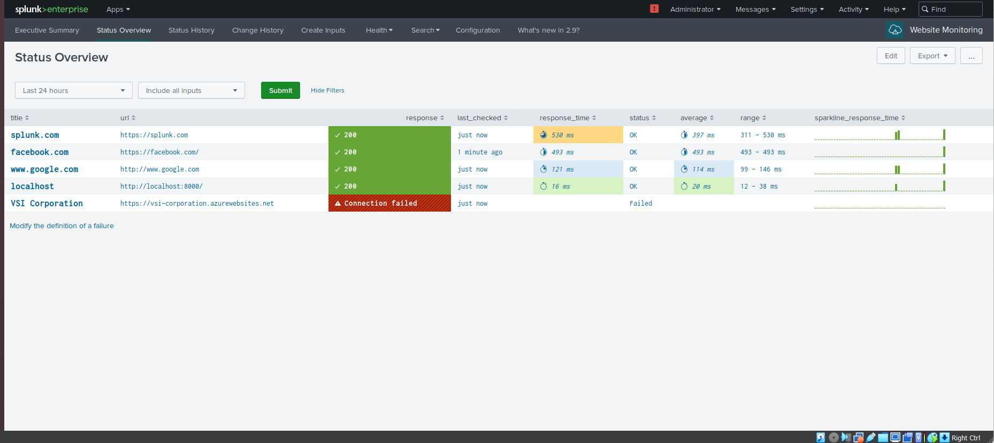
Website Monitoring

Slide 10
Logs Analyzed
Windows Logs
Apache Logs
1
2
-The Windows Logs are comprehensive security logs of the Windows OS back-end server across a 38 hour period, containing 10,709 unique events.
-The logs contain data pertaining to all system logins (success or failure), changes, and modifications to said system, including but not limited to the deletion of an account or the changing of a domain policy.
-Where appropriate, detailed field IDs, response codes, and timestamps are provided.
[-The Apache Logs are comprehensive security logs of the Apache web-server that hosts the VSI administrative website over an 84 hour period (3 days, 12 hours), containing 30,000 unique events.
-The logs contain data pertaining to but not limited to the client IPs accessing the server, the HTTP requests made, as well as numerous other fields of data relevant to their access of the server.
-Where appropriate, detailed information on URIs, response codes, and timestamps are provided.

Slide 11
Windows Logs
‹#›

Slide 12
Reports—Windows
Designed the following Reports:
Report Name | Report Description
VSI Signature and Signature ID Report | A report tabling the Signatures and Signature IDs of the Windows OS logs.
VSI Severity Levels Report | A report charting the counts and percentages of severity levels of the Windows OS logs.
VSI Windows Activities Success and Failures | A report documenting a comparison between Windows Activities successes versus failures using count and percentages.

Slide 13
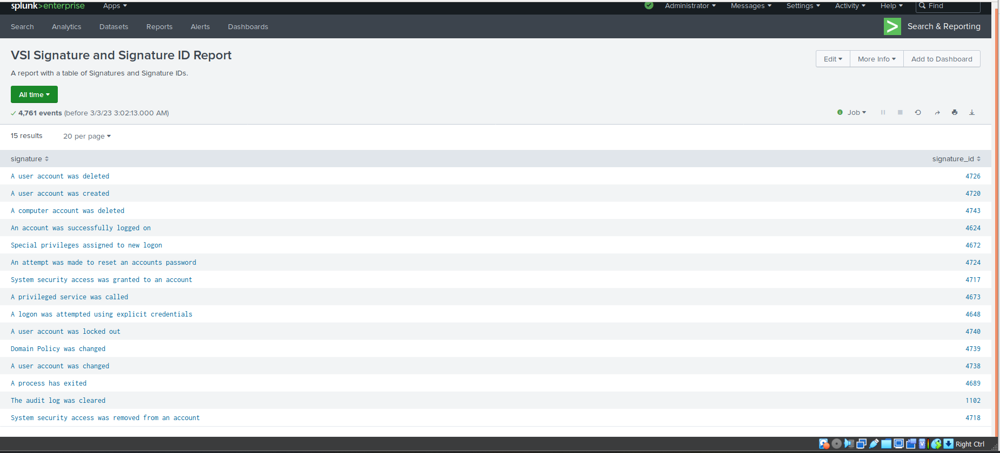
Images of Reports—Windows

Slide 14
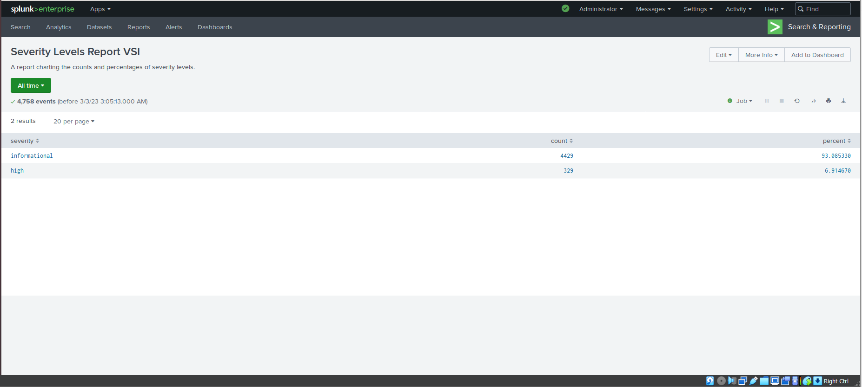
Images of Reports—Windows

Slide 15
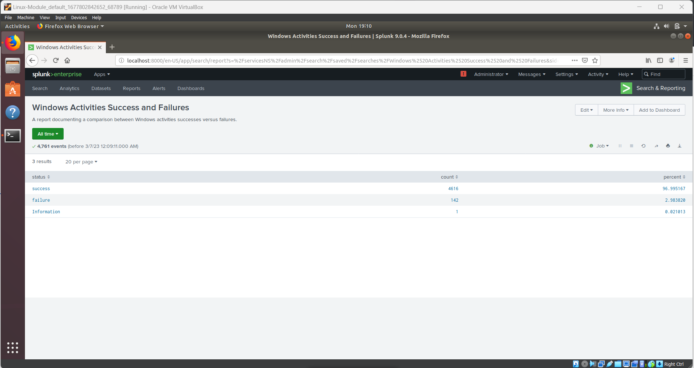
Images of Reports—Windows

Slide 16
Alerts—Windows
Designed the following alerts:
Alert Name | Alert Description | Alert Baseline | Alert Threshold
VSI Failed Windows Activities | Alert for when the number of failed Windows activities exceeds the established threshold for a given hour. | Six - Seven failed activities per hour. | >14 failed activities per hour.
JUSTIFICATION: I established the baseline by using the given logs to calculate the mathematical average number of failed activities per hour. I then took that number, accounted for the statistical outliers, and built a baseline. The alert threshold was generated by using the outliers in the baseline and averaging it with an amount that was roughly double the baseline.

Slide 17
Alerts—Windows
Designed the following alerts:
Alert Name | Alert Description | Alert Baseline | Alert Threshold
Number of Account Logins (ID 4624) | Alert for when the number of successful logins exceeds the established threshold. | 15 successful logins per hour. | 25 successful logins per hour.
JUSTIFICATION: I established the baseline by using the given logs to calculate the mathematical average number of successful logins per hour. I then took that number, accounted for the statistical outliers, and built a baseline. The alert threshold was generated by using the outliers in the baseline and averaging it with an amount that was roughly double the baseline.

Slide 18
Alerts—Windows
Designed the following alerts:
Alert Name | Alert Description | Alert Baseline | Alert Threshold
User Account Deleted | The number of user accounts deleted has exceeded the established threshold per hour. | 13 user accounts deleted per hour. | 25 user accounts deleted per hour.
JUSTIFICATION: I established the baseline by using the given logs to calculate the mathematical average number of deleted accounts per hour. I then took that number, accounted for the statistical outliers, and built a baseline. The alert threshold was generated by using the outliers in the baseline and averaging it with an amount that was roughly double the baseline.

Slide 19
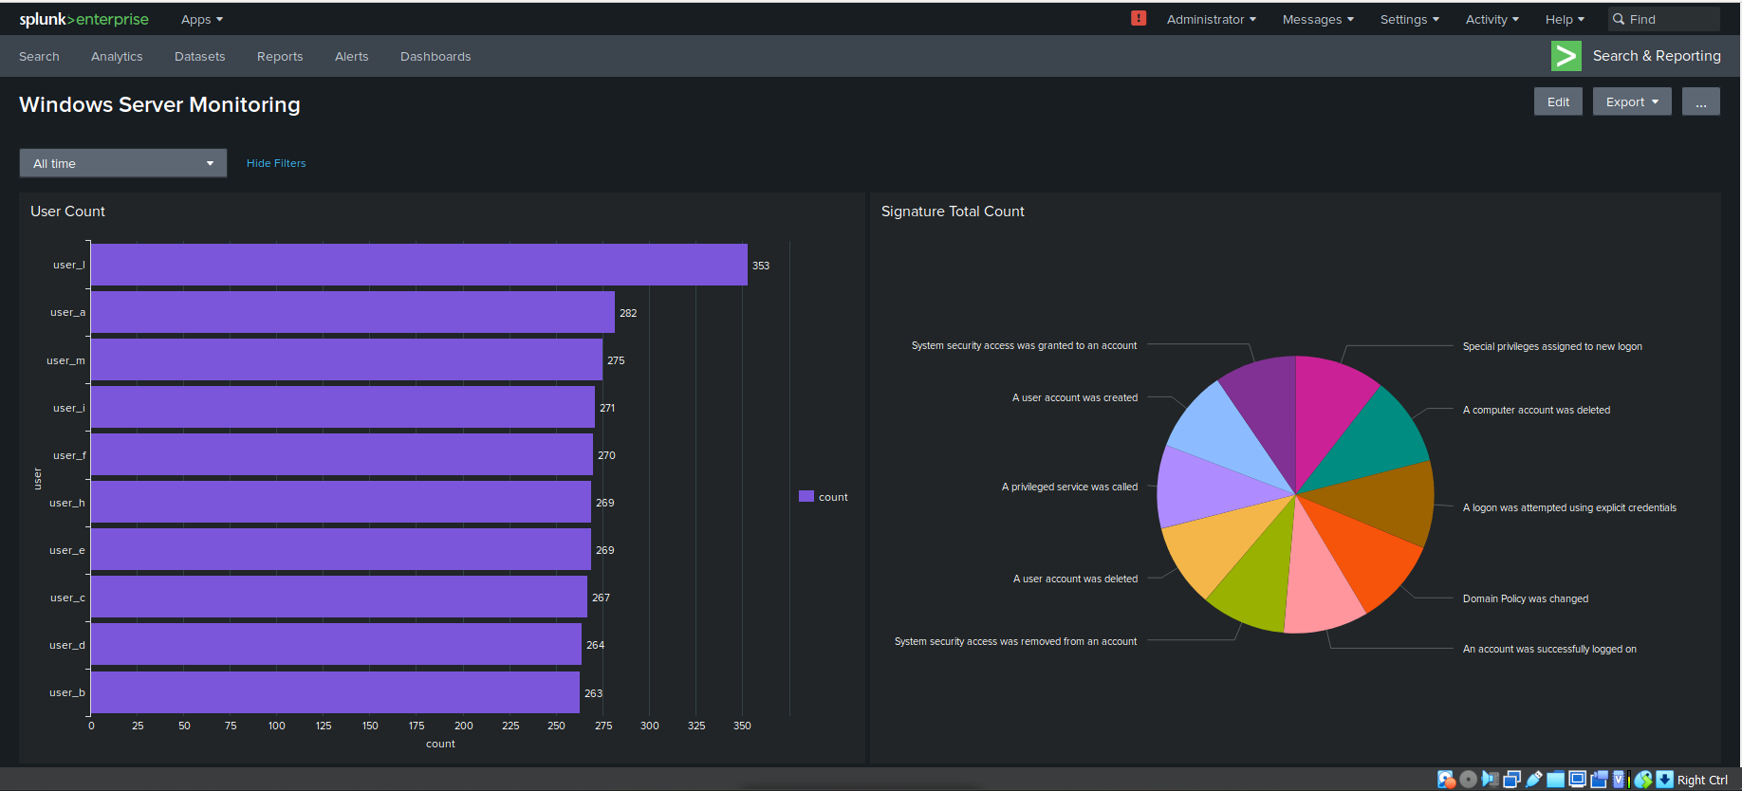
Dashboards—Windows

Slide 20
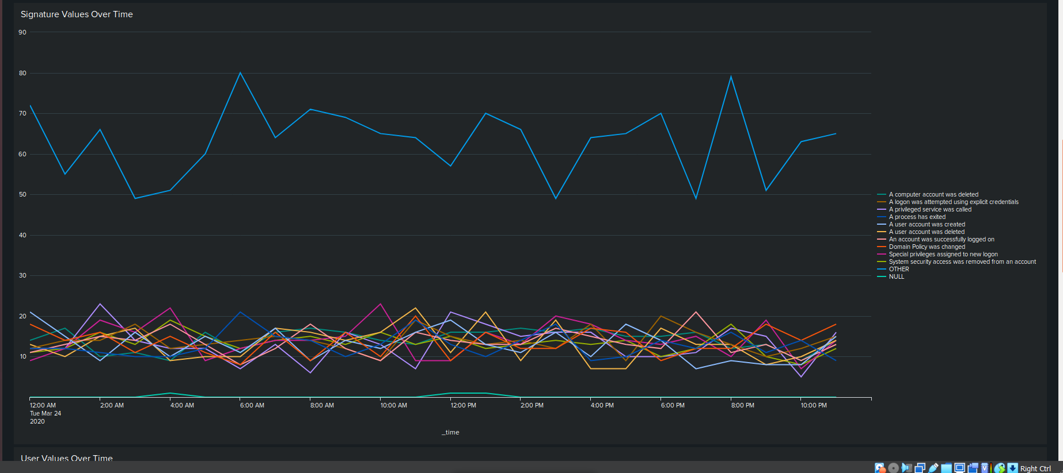
Dashboards—Windows

Slide 21
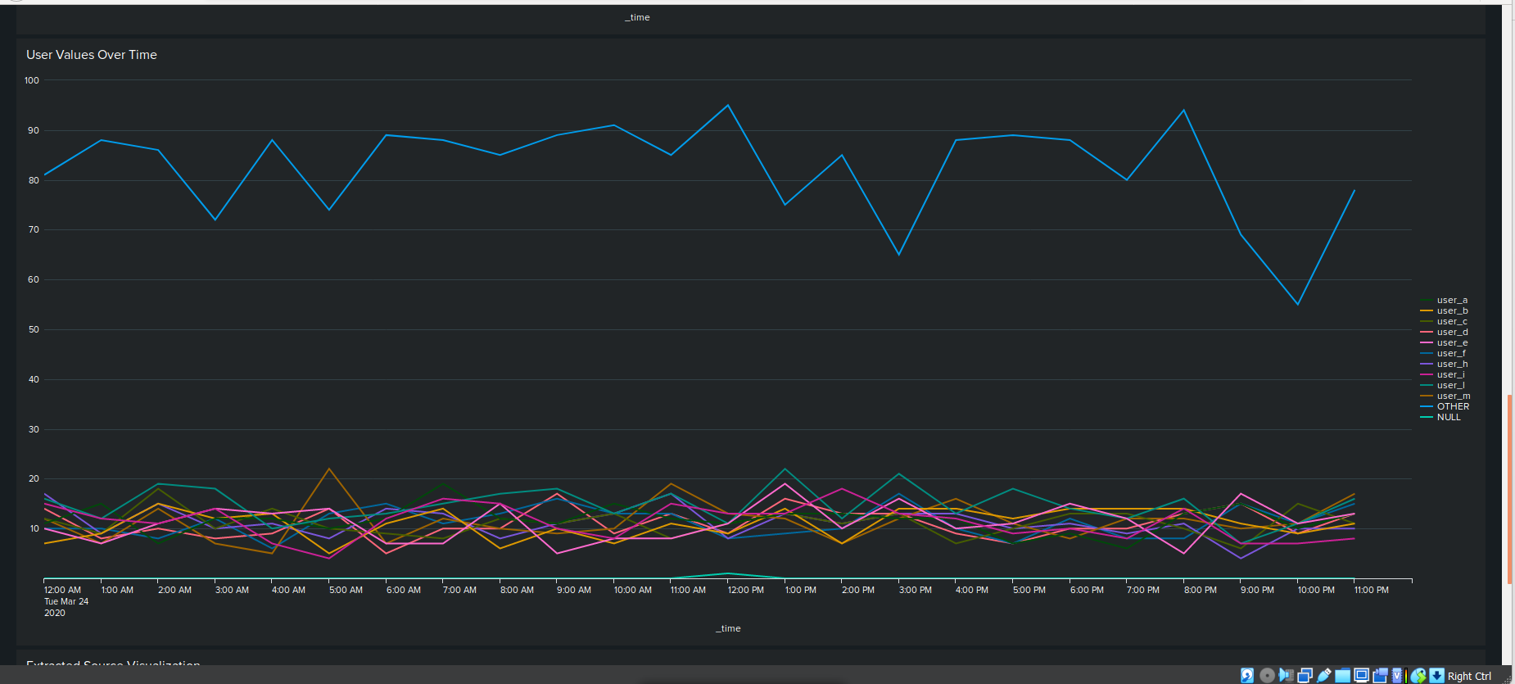
Dashboards—Windows

Slide 22
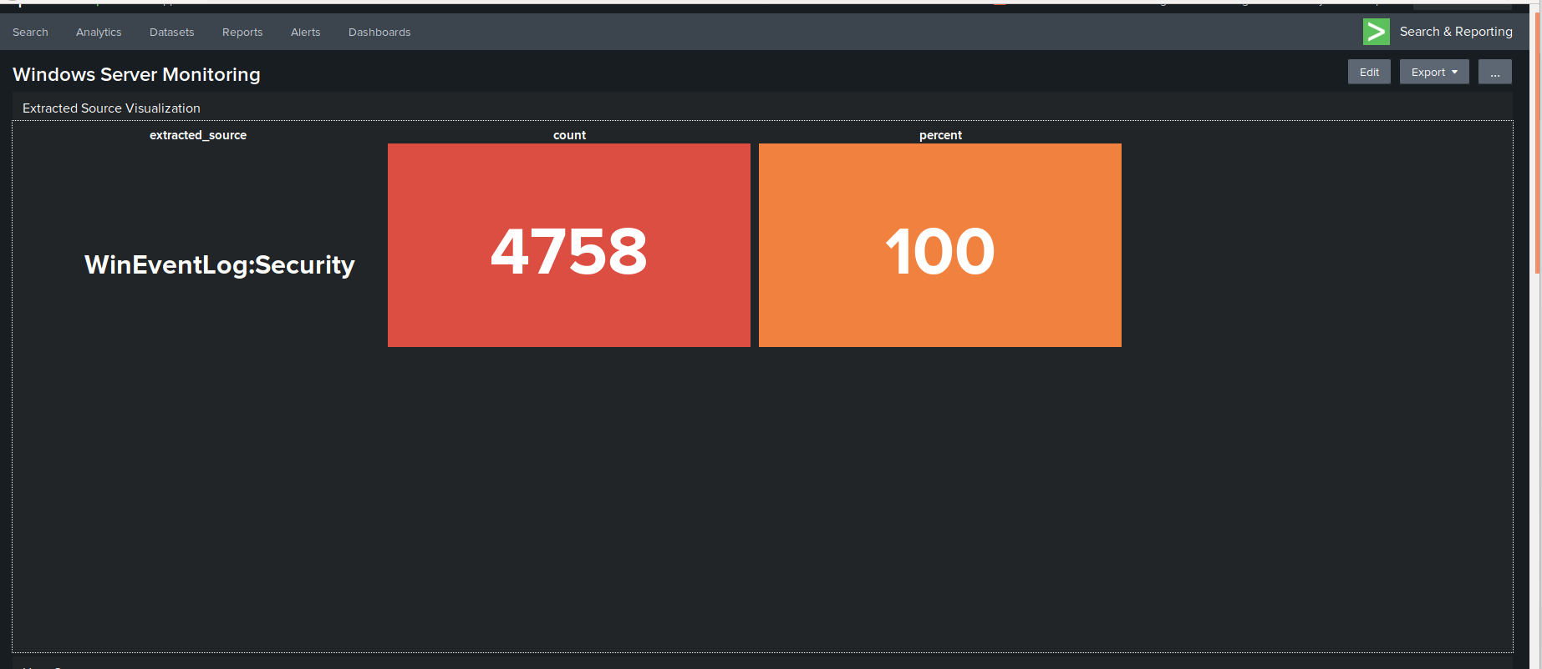
Dashboards—Windows

Slide 23
Apache Logs
‹#›

Slide 24
Reports—Apache
Designed the following reports:
Report Name | Report Description
VSI Apache Method Report | A report tabling the counts and percentages of HTTP requests.
VSI Top 10 Referer Domains | A report of the top 10 domains that refer to VSI’s website.
VSI Count of HTTP Response Codes | A report detailing the count of each HTTP response code.

Slide 25
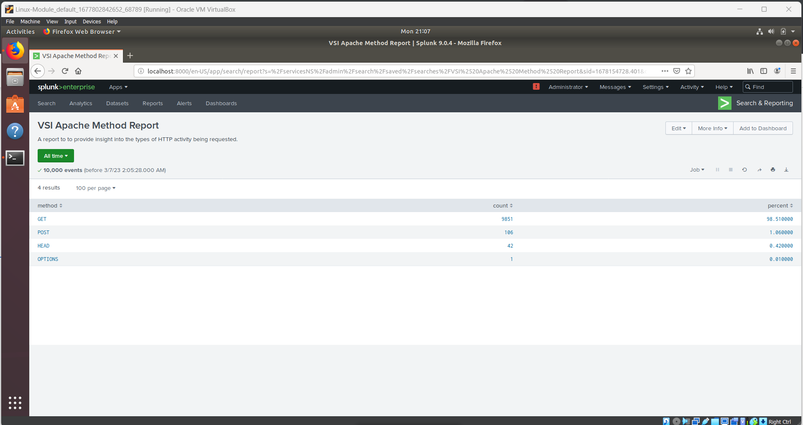
Images of Reports—Apache
Report Image
Report Image

Slide 26
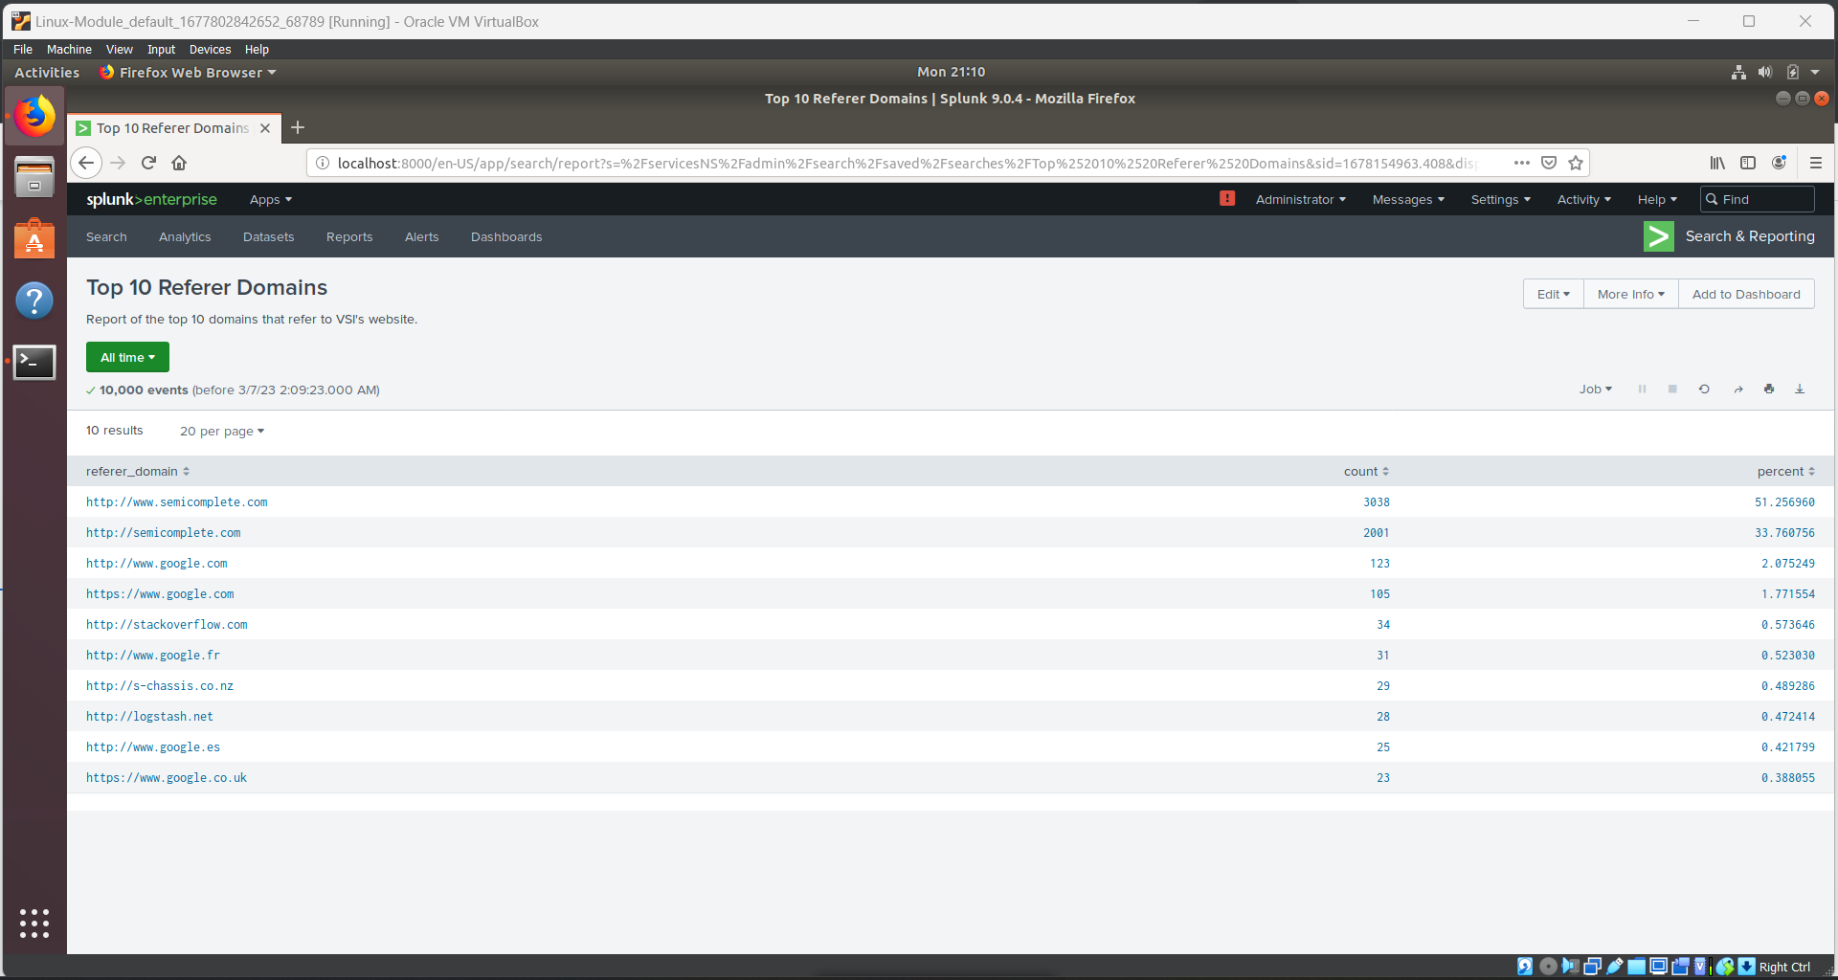
Images of Reports—Apache
Report Image

Slide 27
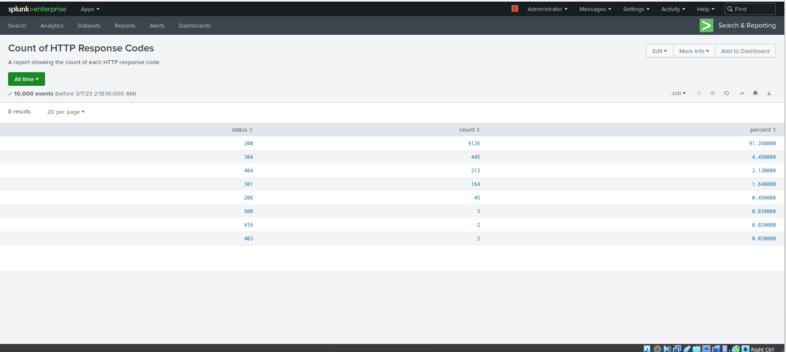
Images of Reports—Apache
Report Image
Report Image

Slide 28
Alerts—Apache
Designed the following alerts:
Alert Name | Alert Description | Alert Baseline | Alert Threshold
HTTP POST Activity | An alert that triggers when the number of HTTP POST requests exceeds the established threshold per hour. | Five HTTP POST requests per hour. | 12 HTTP POST requests per hour.
JUSTIFICATION: I established the baseline by using the given logs to calculate the mathematical average number of HTTP POST requests per hour. I then took that number, accounted for the statistical outliers, many of which included 0 requests per hour, and built a baseline. The alert threshold was generated by using the outliers in the baseline and averaging it with an amount that was roughly double the baseline.

Slide 29
Alerts—Apache
Designed the following alerts:
Alert Name | Alert Description | Alert Baseline | Alert Threshold
Hourly Activity from Outside of the US | An alert that triggers when the numerical amount of activity from IPs from outside the US exceeds the established threshold. | 235 activity requests from IPs outside of the US per hour. | 400 activity requests from IPs outside of the US per hour.
JUSTIFICATION: I established the baseline by using the given logs to calculate the mathematical average number of activity from outside the US per hour. I then took that number, accounted for the statistical outliers, and built a baseline. The alert threshold was generated by using the outliers in the baseline and averaging it with an amount that was roughly double the baseline.

Slide 30
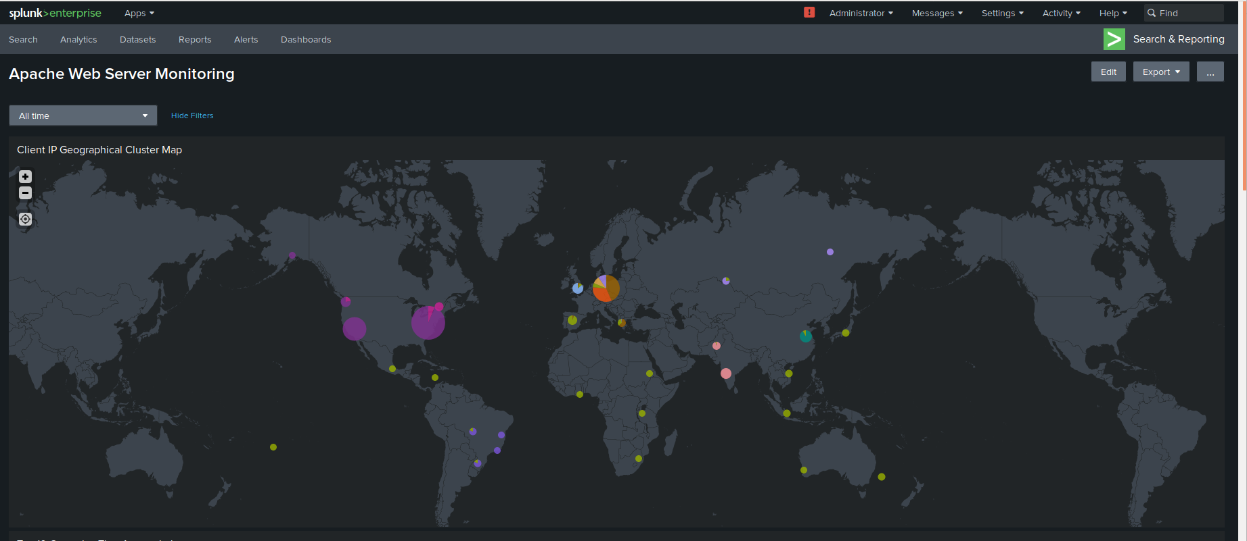
Dashboards—Apache

Slide 31
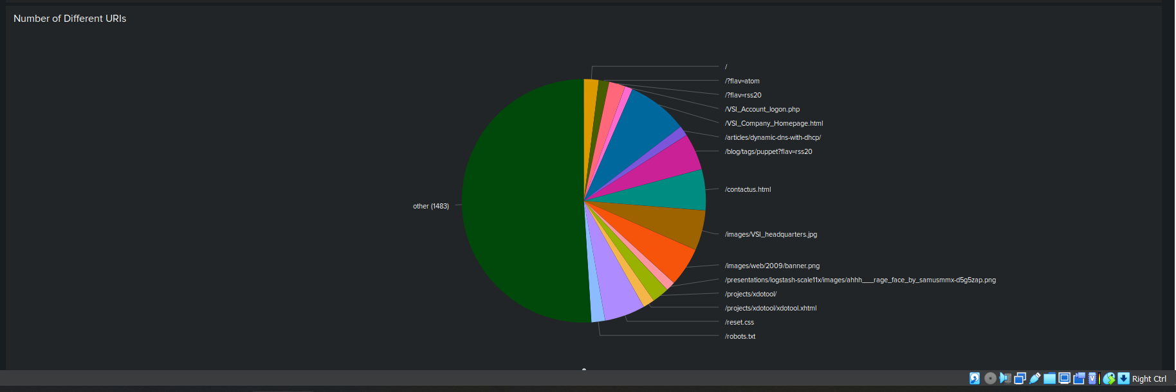
Dashboards—Apache

Slide 32
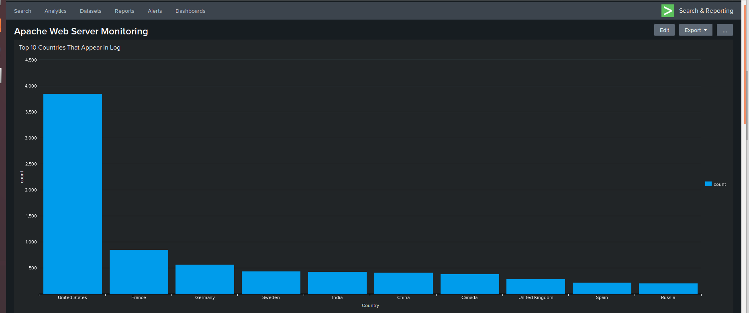
Dashboards—Apache

Slide 33
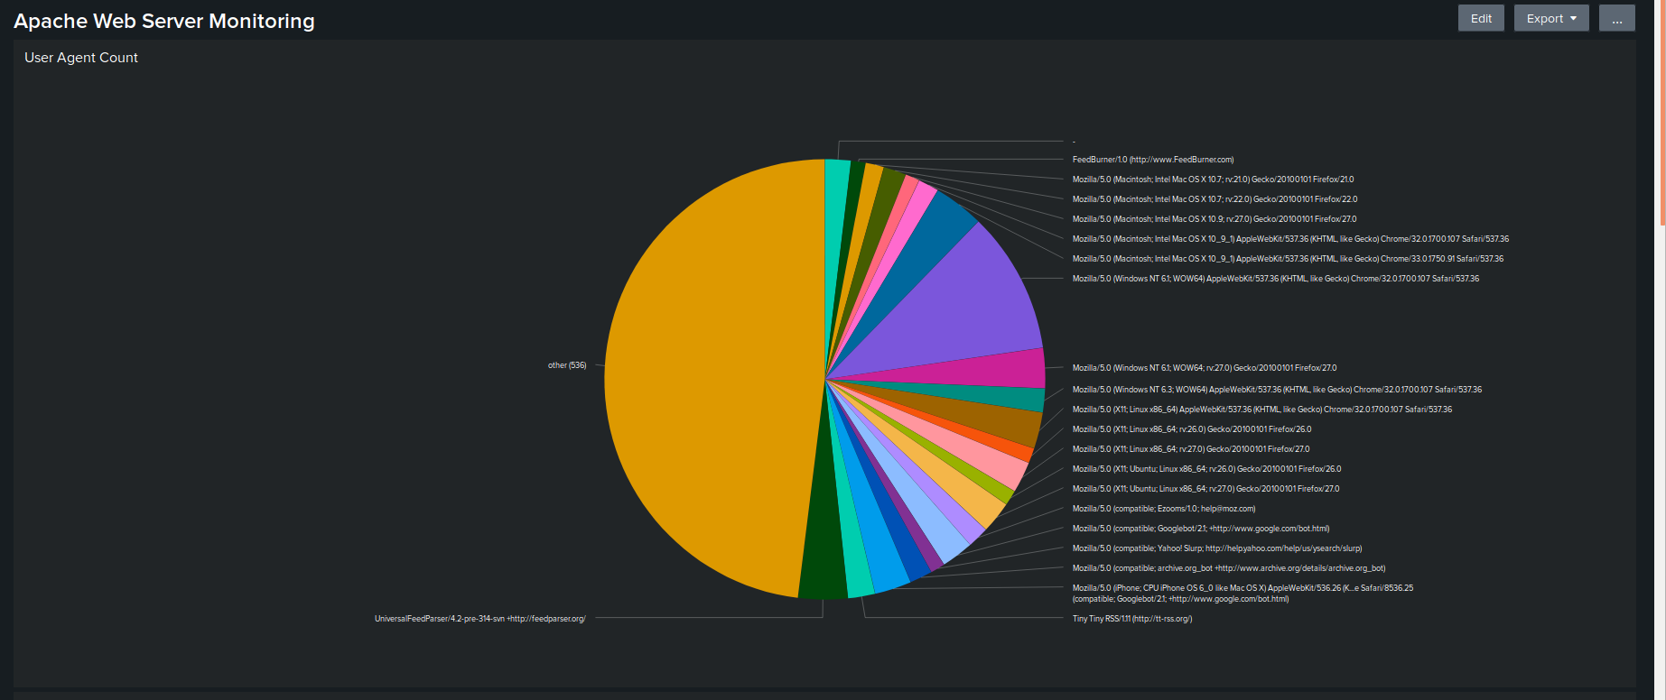
Dashboards—Apache

Slide 34
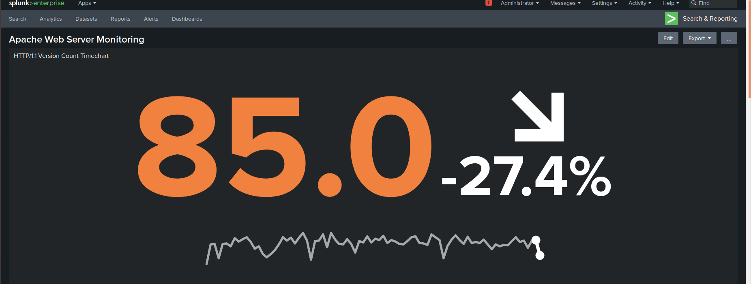
Dashboards—Apache

Slide 35
Attack Analysis
‹#›

Slide 36
Attack Summary—Windows
Summarize your findings from your reports when analyzing the attack logs.
Analyzing the severity levels report revealed a vastly increased percentage of “high” severity level events as opposed to the basic Windows logs.
The Windows activities report revealed that the number of the “failed” Windows activities vastly decreased in the events captured within the attack logs.

Slide 37
Attack Summary—Windows
Summarize your findings from your alerts when analyzing the attack logs. Were the thresholds correct?
The findings from the attack logs revealed that my thresholds for both the “Number of Account Logins” as well as “Number of User Accounts Deleted” were not correct, and would not have triggered an alert. Whether this is because there was no attack targeting a vector that would trigger this alert, or whether the alert values are not where they should be is something I am unable to determine as the values between the two provided logs were startlingly similar.
My threshold for “Failed Windows Logins” would have triggered an alert, informing VSI of the ongoing attack.

Slide 38
Attack Summary—Windows
Summarize your findings from your dashboards when analyzing the attack logs.
The Signature Values over time chart reveals there was an attack in the early AM with the attacker attempting login to the user_a account a large number of times, resulting in lockouts of this account. Later in the same day, an attack occurred in which user_k attempted to reset passwords.
The User values over time revealed dramatic spikes in count for two users, user_a and user_k around the hours of 2AM and 9AM, respectively.

Slide 39
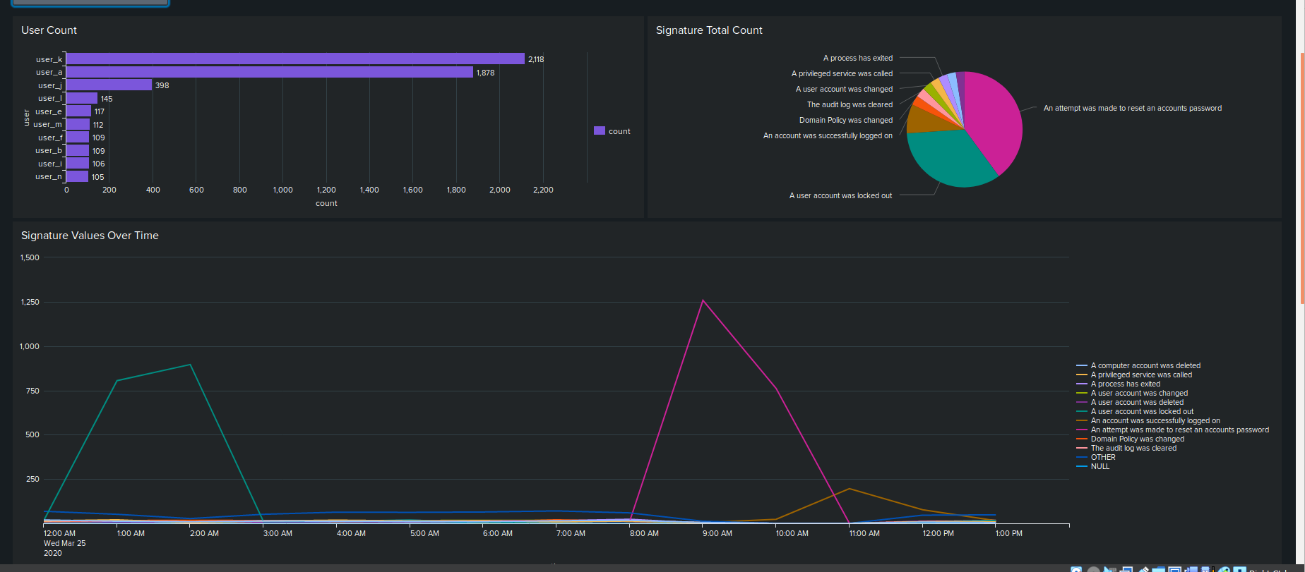

Slide 40
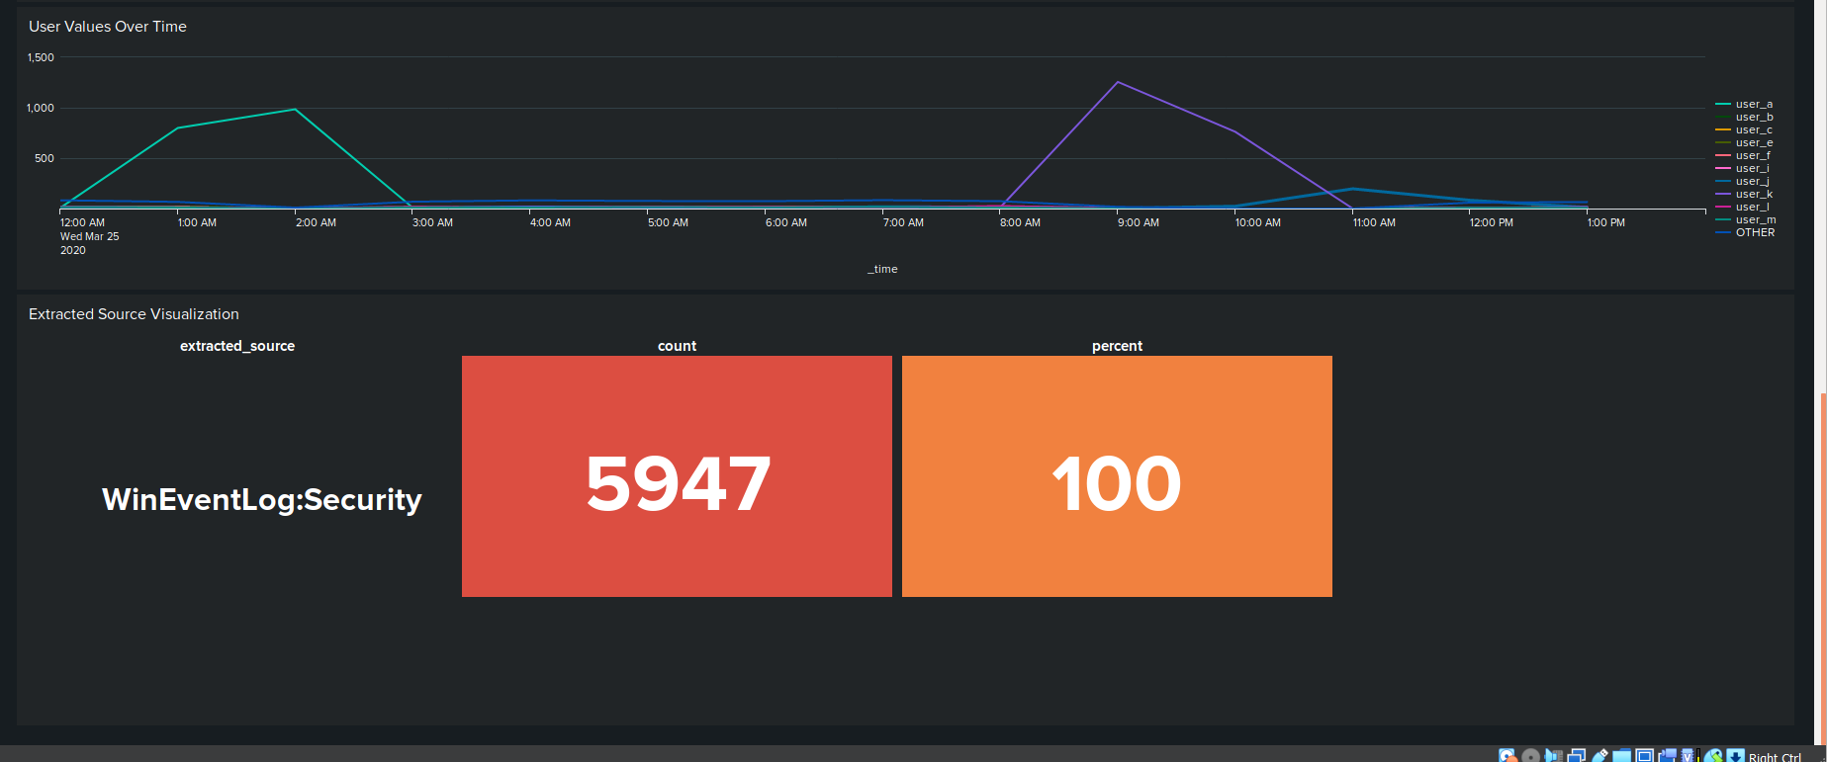

Slide 41
Attack Summary—Apache
Summarize your findings from your reports when analyzing the attack logs.
Analyzing the report on the count of HTTP response codes revealed a sizable increase in the percentage of 404 response codes.
Analyzing the report on the types of HTTP requests being made of the server showed a vast increase in the number of HTTP POST requests being made.
With no meaningful difference in top ten the referrer domains, its reasonable to conclude it played no role in the attack.

Slide 42
Attack Summary—Apache
Summarize your findings from your alerts when analyzing the attack logs. Were the thresholds correct?
Yes, my thresholds were correct. For both of the created alerts, the increase in activity would have been enough to trigger an alert, notifying VSI’s employees of the attack as it was occurring. .

Slide 43
Attack Summary—Apache
Summarize your findings from your dashboards when analyzing the attack logs.
The timechart of HTTP methods revealed that most of the requests were POST requests.
The cluster map of IPs shows a drastic increase in activity from two cities in Ukraine, Kiev and Kharkiv.
The analysis of the URI data shows that the URI that was accessed the most was VSI’s account login page.
In conclusion, analysis of the three dashboard panels show that between the hours of 7pm and 9pm on March 25th, a brute force attack was attempted against VSI from machines in two cities in Ukraine.

Slide 44
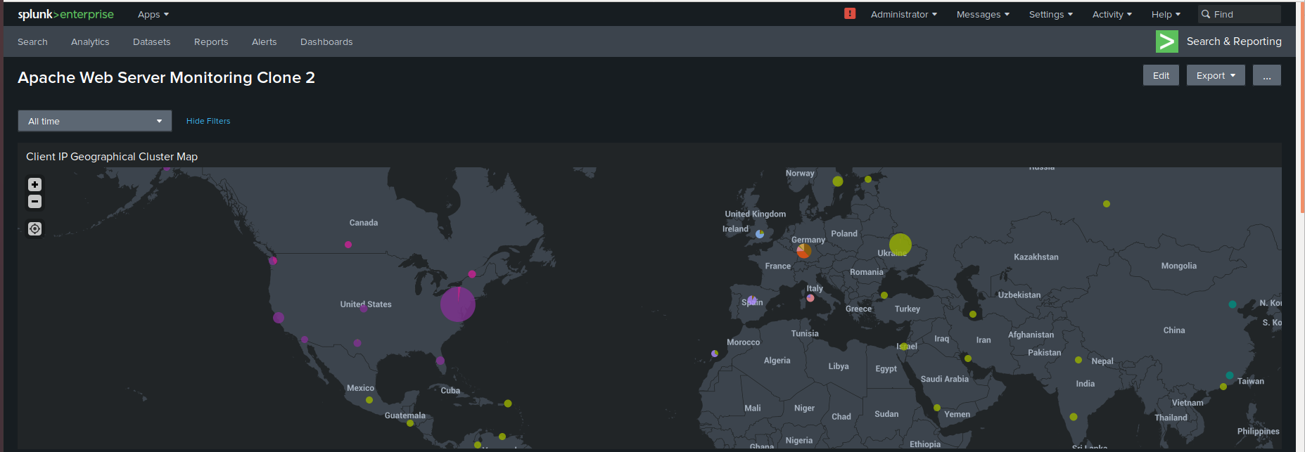

Slide 45
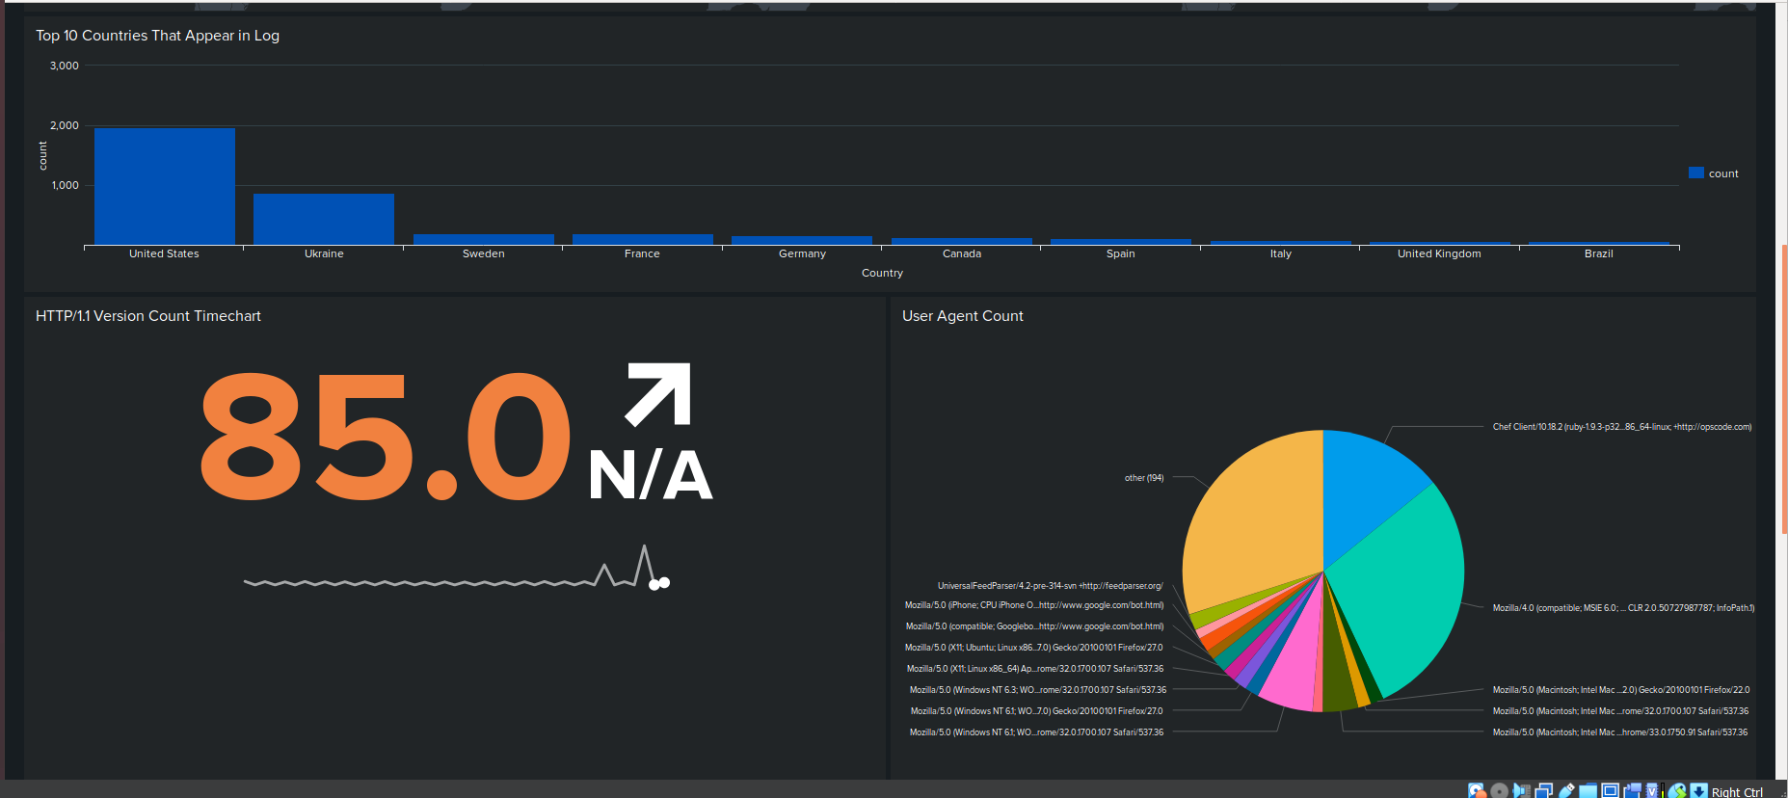

Slide 46
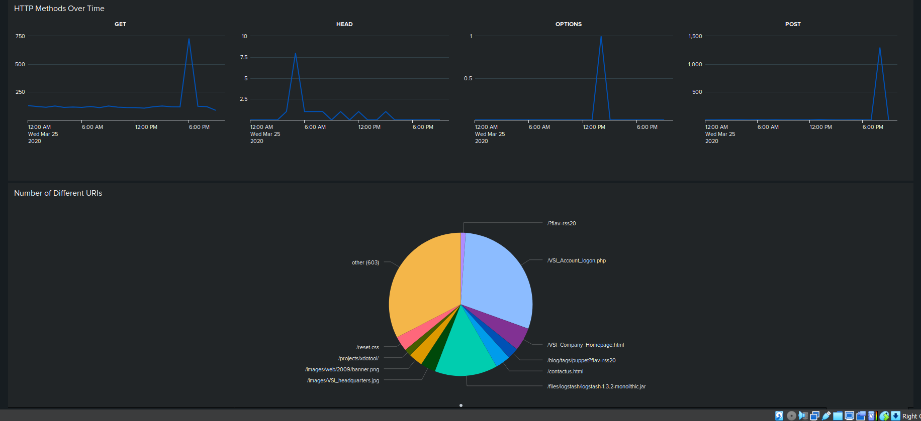

Slide 47
Summary and Future Mitigations
‹#›

Slide 48
Project 3 Summary
What were your overall findings from the attack that took place?
The overall findings suggest that VSI was correct to fear a cybersecurity attack as multiple ones definitely occurred. Said attacks were delivered in the form of what was likely a brute force attack against the company’s administrative website and their back-end server. Numerous attempts to login were made on the web-server. Using two separate users, many attempts were made against the back-end Windows OS system.
To protect VSI from future attacks, what future mitigations would you recommend?
-Implement strong password policies. Ensuring password requirements include a mix of letters, numbers, and characters. Require passwords to be changed regularly.
-Implement multi-factor authentication for all users.
-Set up additional alerts to monitor for traffic from anomalous IP addresses not just outside of the US, but internally as well, and be judicious in blocking these IPs once they’re identified as potential threats.

